Slide 1


Slide 2

Diana A Robledo-Ruiz (she/her)

Slide 3
Hypothetical scenario
Diana A Robledo-Ruiz (she/her)

Slide 4

Hypothetical scenario

Slide 5
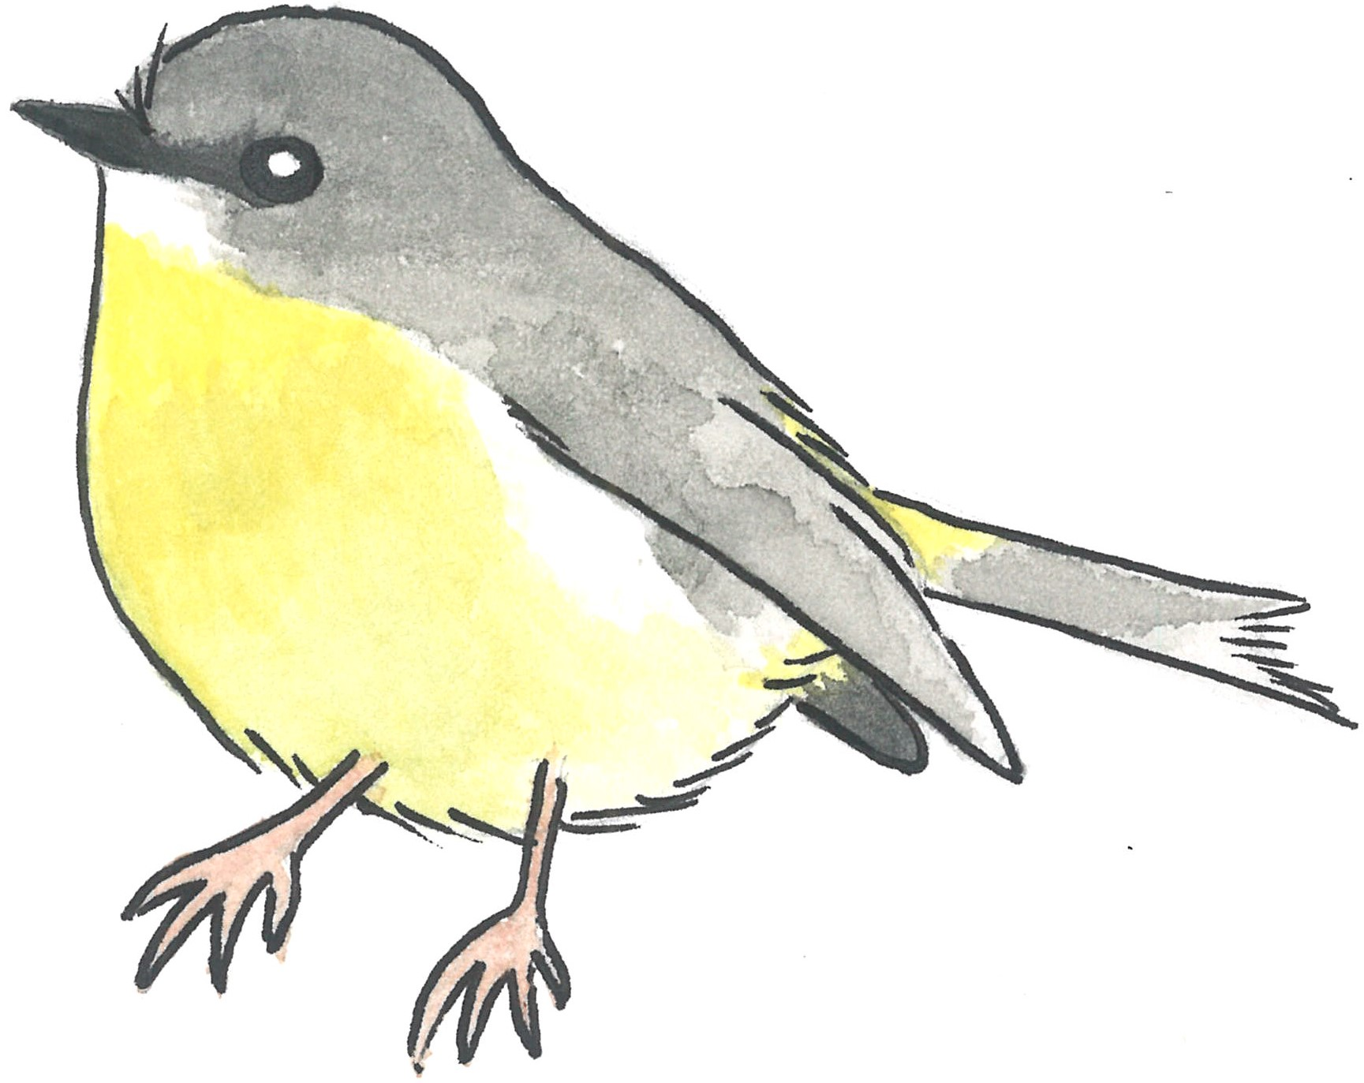
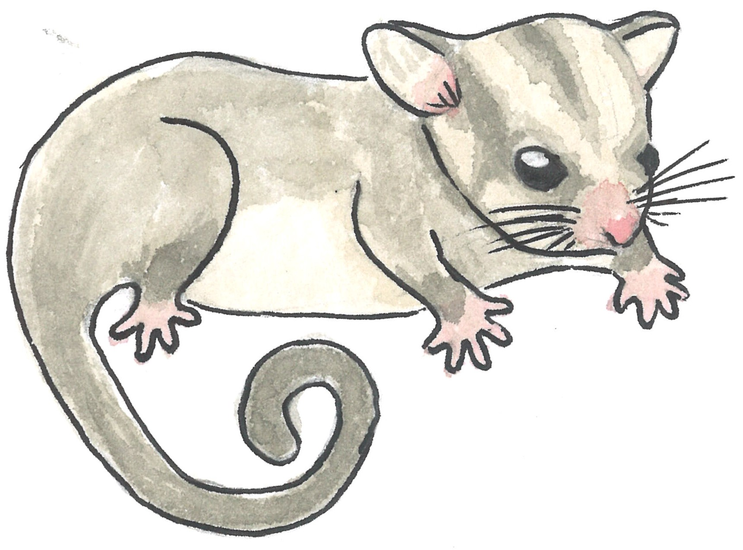
Hypothetical scenario

Slide 6
Genetic diversity
Genetic structure
Parentage analyses

Slide 7

SNPs from DArT, RAD
Filtering
Filter sex-linked loci
SNP quality: read depth
missing data
MAC
Individual quality: missing data

Slide 8
SNPs from DArT, RAD
Filtering
Filter sex-linked loci
SNP quality: read depth
missing data
MAC
Individual quality: missing data

Slide 9
*
Heterozygosity

Slide 10
*
Heterozygosity
PC2
PC1

Slide 11
*
Heterozygosity
PC2
PC1
91 parent-offspring

Slide 12
*
Heterozygosity
PC2
PC1
91 parent-offspring

Slide 13
Heterozygosity
PC2
PC1
104 parent-offspring

Slide 14
What did you miss?

Slide 15
SNPs from DArT, RAD
Filtering
Filter sex-linked loci
SNP quality: read depth
missing data
MAC
Individual quality: missing data
Notes:
It turns out that during filtering you forgot a very important step

Slide 16
SNPs from DArT, RAD
Filtering
Sex-linked loci
SNP quality: read depth
missing data
MAC
Individual quality: missing data
Notes:
To remove sex-linked loci. Like most people, you probably assumed that standard filters would get rid of them. But thoroughly removing them is crucial because

Slide 17
SNPs from DArT, RAD
Filtering
Sex-linked loci
SNP quality: read depth
missing data
MAC
Individual quality: missing data
Popgen analyses assume autosomal loci!
Notes:
My goal for this session is to convince that sex-linked loci are important!

Slide 18
Sex-linked loci and sex chromosomes
Notes:
So, let’s talk about sex-linked loci. Sex linked loci are those that are found in sex chromosomes and therefore “behave” differently in males vs females. There are two main types of sex chromosome systems.

Slide 19
X
Y
X
X
+
Notes:
Mammals have XY chromosomes.

Slide 20
X
Y
X
X
+
Notes:
With males having an X and a Y chromosome

Slide 21
X
Y
X
X
+
Notes:
And females 2 X chr

Slide 22
Z
W
Z
Z
+
X
Y
X
X
+
Notes:
While birds have ZW,

Slide 23
Z
W
Z
Z
+
X
Y
X
X
+
Notes:
With F having a Z and a W chromosome

Slide 24
Z
W
Z
Z
+
X
Y
X
X
+
Notes:
and males have 2 Z chromosomes.

Slide 25



Z
W
Z
Z
+
X
Y
X
X
+
Notes:
Amphibians, fish and reptiles have both sex determination systems (depending on the species).

Slide 26
Z
W
Z
Z
+
Notes:
There are 3 kinds of sex-linked loci. And I will explain them using the ZW sex determination system.

Slide 27
Z
W
Z
Z
W-linked
+
Notes:
W-linked loci are those that are found only in the W-chromosome.

Slide 28
Z
W
Z
Z
+
W-linked
– A
(present)
called
– –
(absent)
missing
+
Notes:
So when sequenced and genotyped, you find that they are usually present (or called) in females, but missing in males.

Slide 29
Z
W
Z
Z
+
W-linked
– A
(present)
called
– –
(absent)
missing
+
0 0.5 1
Call rate Females
Notes:
If you plot the proportion of F in which you called a particular locus versus

Slide 30
Z
W
Z
Z
+
W-linked
– A
(present)
called
– –
(absent)
missing
+
0 0.5 1
Call rate Males
0 0.5 1
Call rate Females
Notes:
versus the proportion of males in which you called the same locus, you will find that W-linked loci are

Slide 31
Z
W
Z
Z
+
W-linked
– A
(present)
called
– –
(absent)
missing
+
0 0.5 1
Call rate Males
0 0.5 1
Call rate Females
Notes:
are here: called in pretty much all females but basically in no male (except for genotyping errors). On the contrary, AUTOSOMAL loci, are called in

Slide 32
Z
W
Z
Z
+
W-linked
– A
(present)
called
– –
(absent)
missing
+
Autosomal
0 0.5 1
Call rate Males
0 0.5 1
Call rate Females
Notes:
Roughly the same proportion of M and F.
The next type of sex-linked loci is

Slide 33
Z
W
Z
Z
+
W-linked
– A
(present)
called
– –
(absent)
missing
Gametolog
Z-linked
+
Autosomal
0 0.5 1
Call rate Males
0 0.5 1
Call rate Females
Notes:
is the Z-linked , that as you probably guessed, are those that are found only in the Z-chromosome.
For these loci, females posses only one allele,

Slide 34
Z
W
Z
Z
+
W-linked
– A
(present)
called
– –
(absent)
missing
Gametolog
Z-linked
+
Autosomal
+
0 0.5 1
Call rate Males
A –
a –
homozygous
0 0.5 1
Call rate Females
Notes:
therefore when genotyped they appear as if they were HOMOzygous.

Slide 35
Z
W
Z
Z
+
W-linked
– A
(present)
called
– –
(absent)
missing
Gametolog
Z-linked
+
Autosomal
+
0 0.5 1
Call rate Males
A A
A a
a a
homozygous
heterozygous
A –
a –
homozygous
0 0.5 1
Call rate Females
Notes:
Males, on the other hand, can be either heterozygous or homozygous.

Slide 36
Z
W
Z
Z
+
W-linked
– A
(present)
called
– –
(absent)
missing
Gametolog
Z-linked
+
Autosomal
+
0 0.5 1
0 0.5 1
% Heterozygous Males
Call rate Males
A A
A a
a a
homozygous
heterozygous
A –
a –
homozygous
0 0.5 1
0 0.5 1
Call rate Females
% Heterozygous Females
Notes:
So when plotting the proportion of heterozygous females against the proportion of heterozygous males, Z-linked loci appear

Slide 37
Z
W
Z
Z
+
W-linked
– A
(present)
called
– –
(absent)
missing
Gametolog
Z-linked
+
Autosomal
+
0 0.5 1
0 0.5 1
% Heterozygous Males
Call rate Males
A A
A a
a a
homozygous
heterozygous
A –
a –
homozygous
0 0.5 1
0 0.5 1
Call rate Females
% Heterozygous Females
Notes:
here, with no females being heterozygous.
In contrast, of course, AUTOSOMAL loci

Slide 38
Z
W
Z
Z
+
W-linked
– A
(present)
called
– –
(absent)
missing
Gametolog
Z-linked
+
Autosomal
Autosomal
+
0 0.5 1
0 0.5 1
% Heterozygous Males
Call rate Males
A A
A a
a a
homozygous
heterozygous
A –
a –
homozygous
0 0.5 1
0 0.5 1
Call rate Females
% Heterozygous Females
Notes:
present no difference in heterozygosity between the sexes. Finally, we also have

Slide 39
Z
W
Z
Z
+
W-linked
– A
(present)
called
– –
(absent)
missing
Gametolog
Gametolog
*
Z-linked
+
Autosomal
Autosomal
+
0 0.5 1
0 0.5 1
% Heterozygous Males
Call rate Males
A A
A a
a a
homozygous
heterozygous
A –
a –
homozygous
0 0.5 1
0 0.5 1
Call rate Females
% Heterozygous Females
Notes:
the gametologs. Gametologs have one allele that is found *exclusively* in the W chromosome, while the other allele can be present in either chromosome.

Slide 40
Z
W
Z
Z
+
W-linked
– A
(present)
called
– –
(absent)
missing
Gametolog
*
Z-linked
+
A A
homozygous
Autosomal
Autosomal
+
0 0.5 1
0 0.5 1
% Heterozygous Males
Call rate Males
A A
A a
a a
homozygous
heterozygous
A –
a –
homozygous
0 0.5 1
0 0.5 1
Call rate Females
% Heterozygous Females
Notes:
Therefore all M are homozygous.

Slide 41
Z
W
Z
Z
+
W-linked
– A
(present)
called
– –
(absent)
missing
Gametolog
*
Z-linked
+
+
A a
A A
heterozygous
homozygous
A A
homozygous
Autosomal
Autosomal
+
0 0.5 1
0 0.5 1
% Heterozygous Males
Call rate Males
A A
A a
a a
homozygous
heterozygous
A –
a –
homozygous
0 0.5 1
0 0.5 1
Call rate Females
% Heterozygous Females
Notes:
While F can be homozygous or heterozygous.

Slide 42
Z
W
Z
Z
+
W-linked
– A
(present)
called
– –
(absent)
missing
Gametolog
*
Z-linked
+
+
A a
A A
heterozygous
homozygous
A A
homozygous
Autosomal
Autosomal
+
0 0.5 1
0 0.5 1
% Heterozygous Males
Call rate Males
A A
A a
a a
homozygous
heterozygous
A –
a –
homozygous
0 0.5 1
0 0.5 1
Call rate Females
% Heterozygous Females
Notes:
So they are here, with no males being heterozygous.
All this is the same for XY sex-determination systems, like those in mammals, just in the opposite direction.

Slide 43
X
Y
X
X
+
Y-linked
– A
(present)
called
– –
(absent)
missing
Gametolog
*
X-linked
+
+
A a
A A
heterozygous
homozygous
A A
homozygous
Autosomal
Autosomal
+
0 0.5 1
0 0.5 1
% Heterozygous Females
Call rate Females
A A
A a
a a
homozygous
heterozygous
A –
a –
homozygous
0 0.5 1
0 0.5 1
Call rate Males
% Heterozygous Males
Notes:
like those in mammals, just in the opposite direction.

Slide 44
Applications of sex-linked loci
1. REMOVE THEM: Facilitate unbiased popgen analyses
Autosomal
Notes:
What can you do with sex-linked loci? Remove them from your dataset in order to…

Slide 45
X
Y
X
X
+
Y-linked
– A
(present)
called
– –
(absent)
missing
Gametolog
X-linked
+
+
A a
A A
heterozygous
homozygous
A A
homozygous
Autosomal
Autosomal
+
0 0.5 1
0 0.5 1
% Heterozygous Females
Call rate Females
A A
A a
a a
homozygous
heterozygous
A –
a –
homozygous
0 0.5 1
0 0.5 1
Call rate Males
% Heterozygous Males
Notes:
How though? How would you remove sex-linked loci?

Slide 46
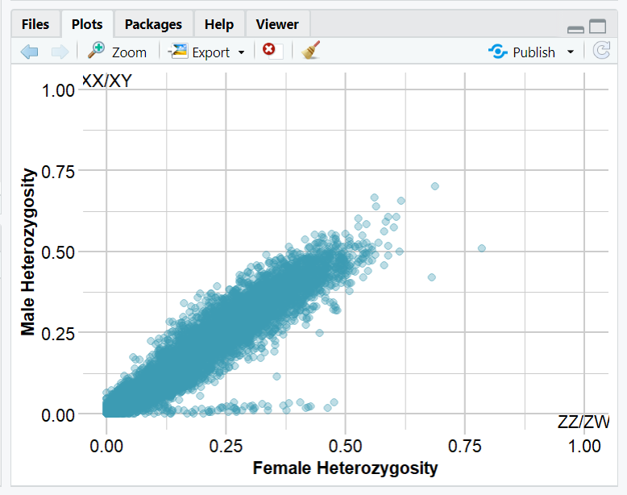
Notes:
For example, this is real SNPs data from a mammal population. How would you go about removing these sex-linked loci?

Slide 47
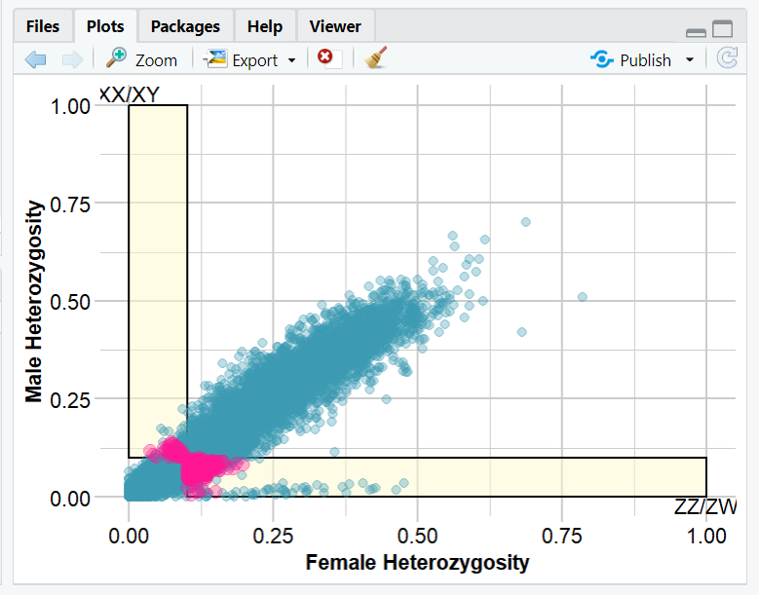
Notes:
Manually set a threshold. That is what the previous dartR version would allow you to do.
However, there were some disadvantages. Can you think of any? Where to put the threshold

Slide 48
Notes:
How about this locus? WHY? justification

Slide 49
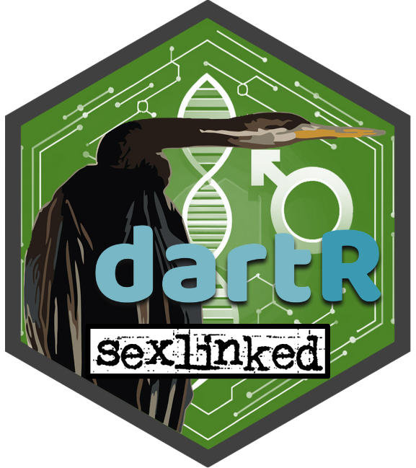
New package with function that does it automatically!
Notes:
This package has a new version that identifies sex-linked loci automatically. Without the user choosing thresholds

Slide 50
gl.filter.sexlinked
Notes:
The function is called

Slide 51
gl.filter.sexlinked
0 0.5 1
0 0.5 1
% Heterozygous Males
Call rate Males
0 0.5 1
0 0.5 1
Call rate Females
% Heterozygous Females
Notes:
And it uses the property of autosomal loci of having this roughly 1:1 relationship in call rate and proportion of heterozygous individuals.

Slide 52
gl.filter.sexlinked
0 0.5 1
0 0.5 1
% Heterozygous Males
Call rate Males
0 0.5 1
0 0.5 1
Call rate Females
% Heterozygous Females
Notes:
It applies statistical tests to identify loci that significantly deviate from it.
The function works in 2 stages:

Slide 53
gl.filter.sexlinked
0 0.5 1
0 0.5 1
% Heterozygous Males
Call rate Males
0 0.5 1
0 0.5 1
Call rate Females
% Heterozygous Females
 | M | F
Called | 230 | 0
Missing | 1 | 170
Notes:
FIRST, for each locus, it performs a Fisher’s exact test in which it checks whether the call rate of the locus depends on sex, if it does, it is classified as sex-linked. If it doesn’t, it performs a SECOND Fisher’s exact test

Slide 54
gl.filter.sexlinked
0 0.5 1
0 0.5 1
% Heterozygous Males
Call rate Males
0 0.5 1
0 0.5 1
Call rate Females
% Heterozygous Females
 | M | F
Called | 230 | 0
Missing | 1 | 170
 | M | F
Homo | 2 | 228
Het | 171 | 0
Notes:
To check whether the number of het individuals depends on the sex of the individuals, if it does, it is classified as sex-linked. Otherwise, the locus is considered autosomal.

Slide 55
gl.filter.sexlinked
0 0.5 1
0 0.5 1
% Heterozygous Males
Call rate Males
0 0.5 1
0 0.5 1
Call rate Females
% Heterozygous Females
Notes:
As you may appreciate, this is a gorgeous solution, because it statistically tells you whether a locus deviates so much from the 1:1 relationship that it is statistically unlikely to be autosomal. You don’t need to set any $$$ threshold.
The function is super easy to use, it requires only two things:

Slide 56
gl.filter.sexlinked(gl.object,
Notes:
One, of course, is the SNP data, in the form of a genlight object.

Slide 57
sex
gl.filter.sexlinked(gl.object,
Notes:
in which one specifies the sex of each individual (ind.metrics)

Slide 58
zw
sex
zw
xy
gl.filter.sexlinked(gl.object, )
Notes:
And the second thing is simply to specify the sex-determination system

Slide 59
zw
sex
zw
xy
gl.filter.sexlinked(gl.object, )
W-linked
Gametolog
Z-linked
Autosomal
Notes:
And tadá! It separates the types of loci. It creates a genlight object for each type.

Slide 60
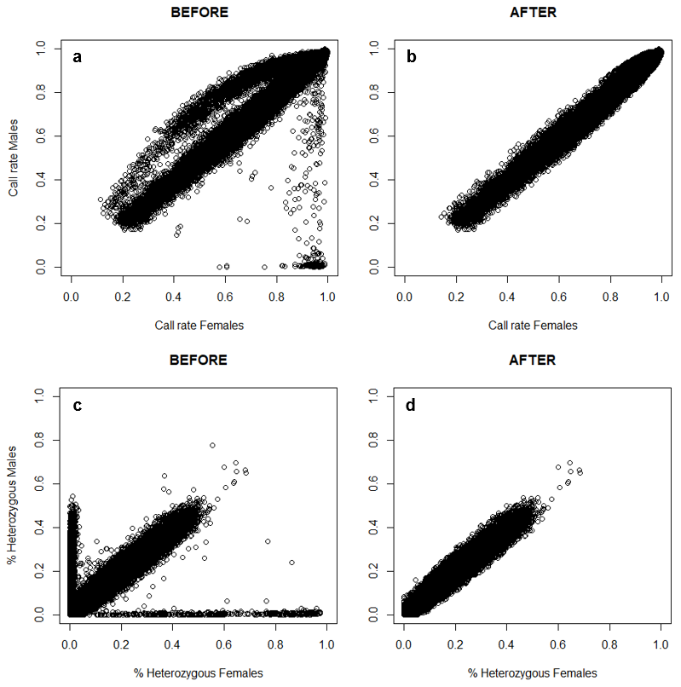
sex
zw
xy
gl.filter.sexlinked(gl.object, )
Call rate Males
W-linked
Gametolog
Call rate Females
Call rate Females
Z-linked
Autosomal
Notes:
Leaving the autosomal loci alone, so your final dataset goes from this, to this.

Slide 61
zw
sex
zw
xy
gl.filter.sexlinked(gl.object, )
Call rate Males
W-linked
Gametolog
Call rate Females
Call rate Females
Z-linked
% Heterozygous Males
Autosomal
% Heterozygous Females
% Heterozygous Females
Notes:
And this to that.
Now, there is another “type” of sex-linked loci that the function identifies. We named “sex-biased”

Slide 62
zw
sex
zw
xy
gl.filter.sexlinked(gl.object, )
Sex-biased
Call rate Males
W-linked
Gametolog
Call rate Females
Call rate Females
Z-linked
% Heterozygous Males
Autosomal
% Heterozygous Females
% Heterozygous Females
Notes:
And it is these guys that are over here. They are not W-linked loci, those are here. If you notice, these are loci that are better called in males than females. So for example,
They are actually Z-linked loci, and they have a call rate biased towards males because males have 2 Z chr (and females only one).

Slide 63
zw
sex
zw
xy
gl.filter.sexlinked(gl.object, )
Sex-biased
Call rate Males
W-linked
Gametolog
Call rate Females
Call rate Females
Z-linked
% Heterozygous Males
Autosomal
% Heterozygous Females
% Heterozygous Females
Notes:
And it is these guys that are over here. They are not W-linked loci, those are here. If you notice, these are loci that are better called in males than females. So for example,
They are actually Z-linked loci, and they have a call rate biased towards males because males have 2 Z chr (and females only one).

Slide 64
sex
zw
xy
gl.filter.sexlinked(gl.object, )
Sex-biased
Call rate Males
W-linked
Gametolog
Call rate Females
Call rate Females
Z-linked
% Heterozygous Males
Autosomal
98.8%
% Heterozygous Females
% Heterozygous Females
Notes:
The function is 98.8% accuracy at correctly identifying autosomal loci! 87.8
OK so. All this is cool. But maybe you are thinking

Slide 65
Is removing sex-linked loci necessary?
Notes:
Diana, I am going to apply a lot of filters any way (like read depth, MAC, missing data). Is it really necessary to use this function?
Does it really make any difference?

Slide 66
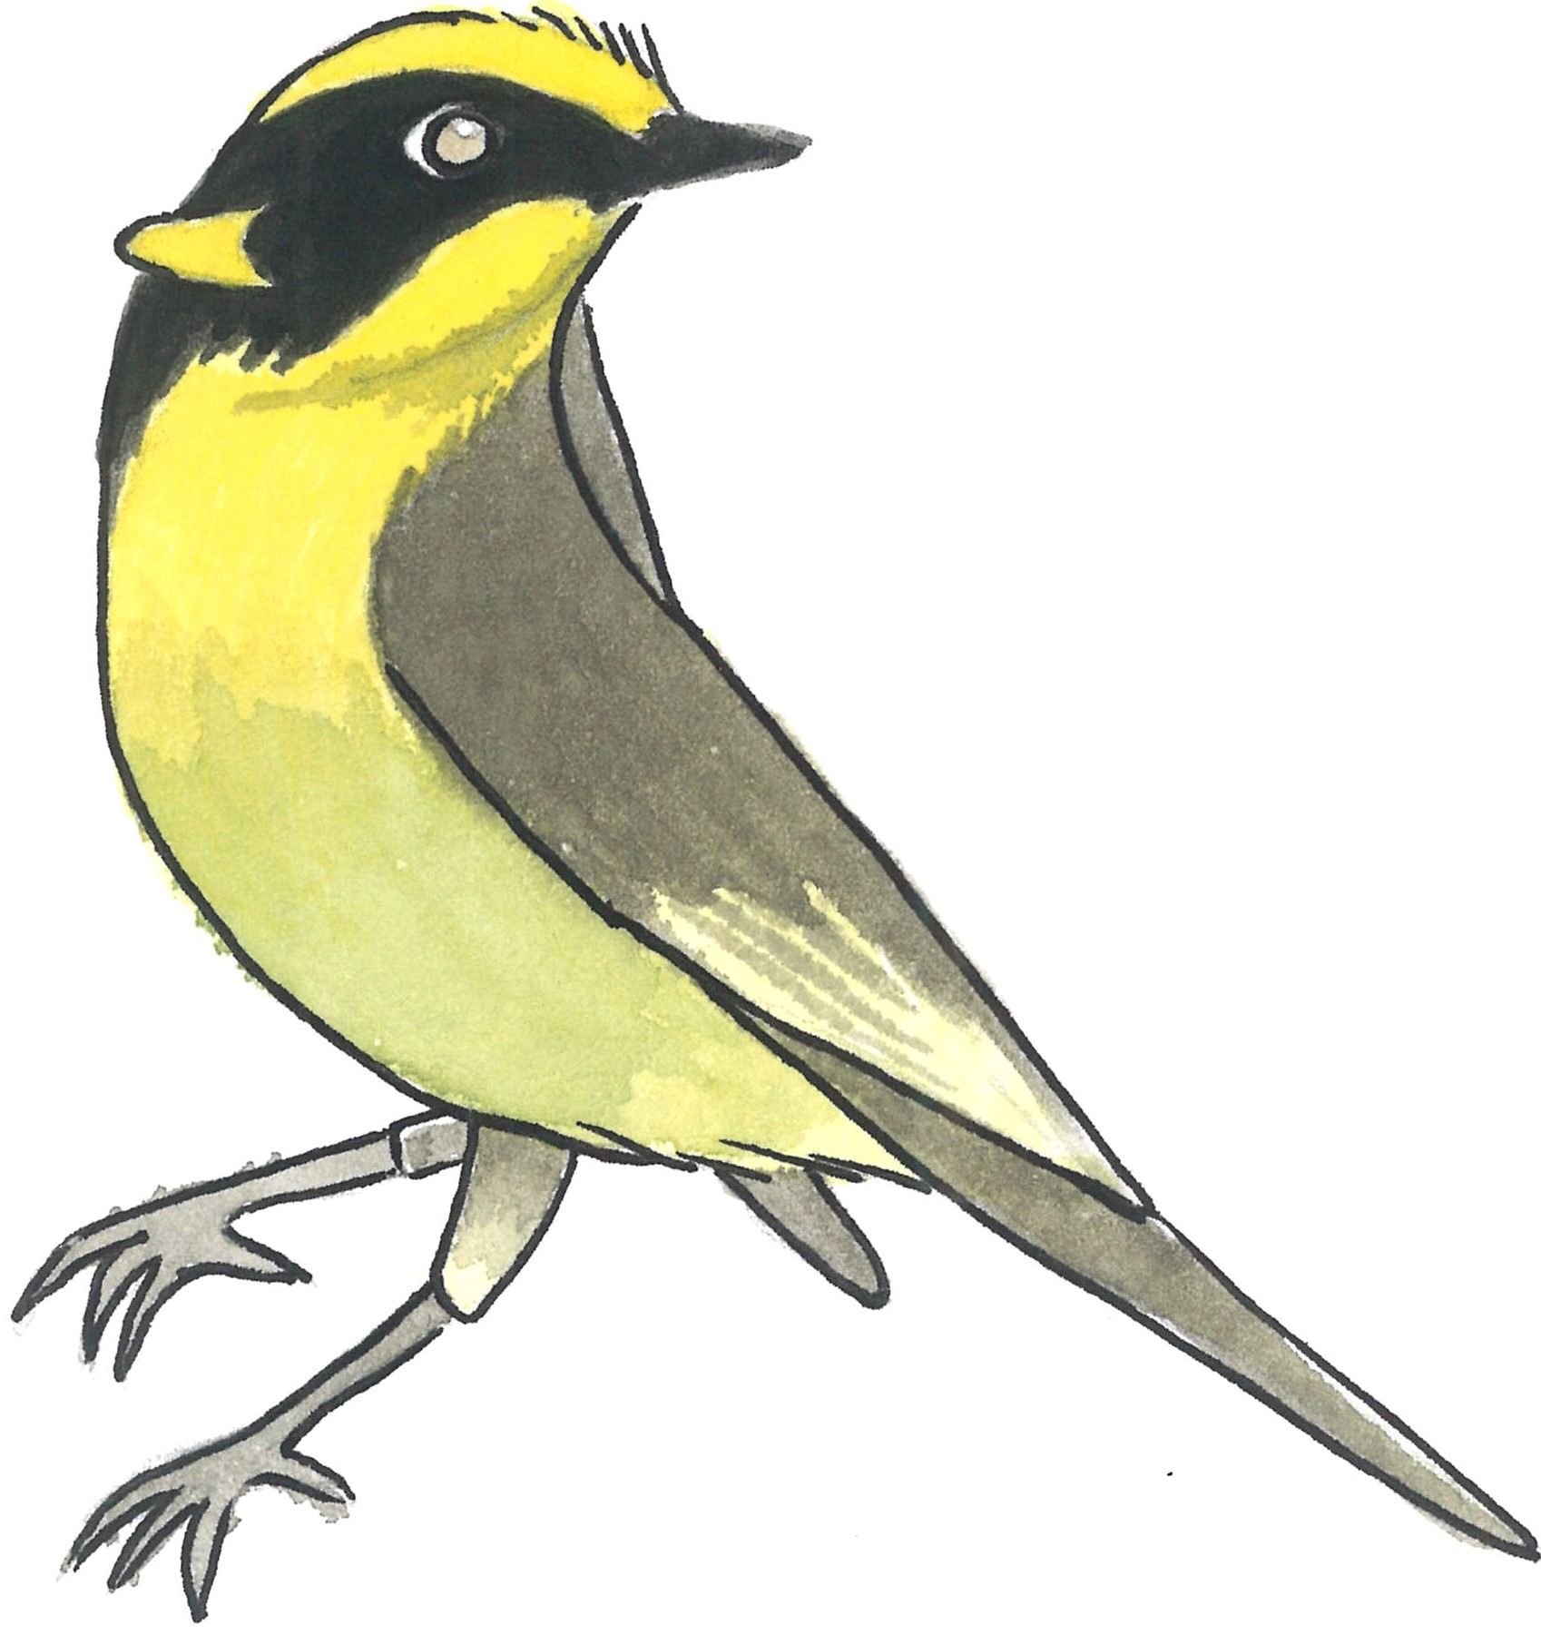
Yellow-tufted Honeyeater
Eastern Yellow Robin
Notes:
For these fair questions, we used REAL genetic data of two beloved Australian birds:
To each dataset, we applied two SNP filtering regimes.

Slide 67
Sloppy SNP filtering
Loci read depth
Loci missing data
Ind. missing data
Loci MAC
Notes:
One incorrect one in which we applied standard filters, but we did not remove sex-linked loci.

Slide 68
Sloppy SNP filtering
Loci read depth
Loci missing data
Ind. missing data
Loci MAC
Correct SNP filtering
Sex-linked loci
Loci read depth
Loci missing data
Ind. missing data
Loci MAC
Notes:
And one correct one in which we DID remove sex-linked loci with our function.
Then we asked two questions:

Slide 69
Sloppy SNP filtering
Loci read depth
Loci missing data
Ind. missing data
Loci MAC
Correct SNP filtering
Sex-linked loci
Loci read depth
Loci missing data
Ind. missing data
Loci MAC
1
How good are standard filters at removing sex-linked loci?
Notes:
Ok, so by applying these two filtering regimes, one incorrect and one correct, we explored:

Slide 70
Sloppy SNP filtering
Loci read depth
Loci missing data
Ind. missing data
Loci MAC
Correct SNP filtering
Sex-linked loci
Loci read depth
Loci missing data
Ind. missing data
Loci MAC
1
How good are standard filters at removing sex-linked loci?
How do sex-linked loci affect popgen results?
2
Notes:
In the case that standard filters do no remove all sex-linked loci, do the unfiltered sex-linked loci affect the results of population genetic analyses?

Slide 71
INITIAL DATASET
INITIAL DATASET
W-linked
Z-linked
Gametolog
W-linked
Z-linked
Gametolog
YTH
EYR
100%
100%
100%
100%
100%
100%
Read depth
Loci
missing data
Individual missing data
+
MAC
FINAL DATASET
FINAL DATASET
Notes:
First, we found that standard filters are not very good at removing all types of sex-linked loci.

Slide 72
INITIAL DATASET
INITIAL DATASET
W-linked
Z-linked
Gametolog
W-linked
Z-linked
Gametolog
YTH
EYR
100%
100%
100%
100%
100%
100%
Read depth
75%
49%
Loci
missing data
Individual missing data
+
MAC
FINAL DATASET
FINAL DATASET
Notes:
Read depth and loci missing data filters are good at removing W-linked loci: after applying both, NO W-linked loci remained in the final datasets and that is good. BUT

Slide 73
INITIAL DATASET
INITIAL DATASET
W-linked
Z-linked
Gametolog
W-linked
Z-linked
Gametolog
YTH
EYR
100%
100%
100%
100%
100%
100%
Read depth
75%
75%
62%
49%
81%
80%
Loci
missing data
60%
75%
71%
37%
Individual missing data
+
MAC
57%
75%
71%
37%
FINAL DATASET
FINAL DATASET
Notes:
BUT even the combination of all these standard filters was terribly inefficient at removing the other sex-linked loci. For YTH, more than half of Z-linked loci and over a third of gametologs remained. And for EYR, over 70% of Z-linked and gametologs remained.
This meant that of the final SNP dataset for YTH,

Slide 74
INITIAL DATASET
INITIAL DATASET
W-linked
Z-linked
Gametolog
W-linked
Z-linked
Gametolog
YTH
EYR
100%
100%
100%
100%
100%
100%
Read depth
75%
75%
62%
49%
81%
80%
Loci
missing data
60%
75%
71%
37%
Individual missing data
+
MAC
57%
75%
71%
37%
5.7%
7.8%
FINAL DATASET
FINAL DATASET
Notes:
5.7% were sex-linked. And 7.8 for EYR.

Slide 75
Take home message no. 1
Standard filters suck at removing all sex-linked loci
Notes:
Ok, good, we got our first take home message. Standard filters kinda suck at removing sex-linked loci.
How does this percentage affect population genetic analyses?

Slide 76
*
Heterozygosity
5%
YTH
Notes:
When those sex-linked loci remained in the dataset, we wrongly found that female YTH were 5% less heterozygous than M. Btw, this results was statistically significant. Which could have indicated

Slide 77
*
Heterozygosity
5%
YTH
Female philopatry
Inbred males are dying (inbreeding depression)
Notes:
Females are philopatric, or that inbred males are dying, so that they suffer from stronger inbreeding depression

Slide 78
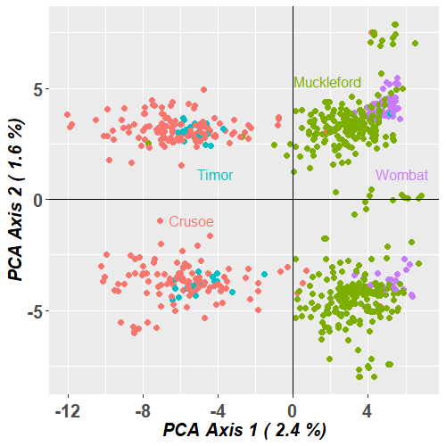
*
Heterozygosity
5%
YTH
EYR
Female philopatry
Inbred males are dying (inbreeding depression)
Notes:
For EYR, individuals appeared to be divided in two groups for each sampling location.

Slide 79
*
Heterozygosity
5%
YTH
EYR
Female philopatry
Inbred males are dying (inbreeding depression)
Two cryptic sympatric
species
Notes:
Which could have suggested that perhaps they are

Slide 80
*
Heterozygosity
5%
YTH
EYR
Female philopatry
Inbred males are dying (inbreeding depression)
Two cryptic sympatric
species
91 parent-offspring
YTH
Notes:
And we found 91 parent-offspring pairs in YTH

Slide 81
*
Heterozygosity
5%
YTH
EYR
Female philopatry
Inbred males are dying (inbreeding depression)
Two cryptic sympatric
species
Extra-pair paternity
Captive breeding
Translocations
91 parent-offspring
YTH
Notes:
Which would have been used to estimate EPP, or maybe guide captive breeding or even translocations in the wild.
But in reality, these spurious results

Slide 82
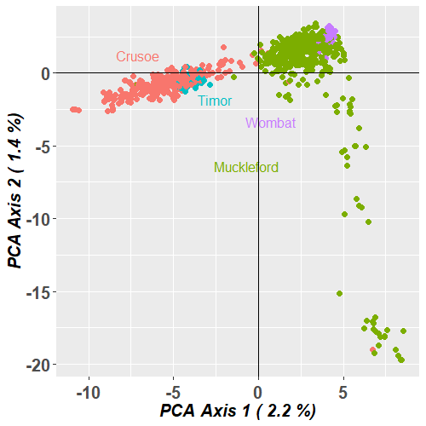
Heterozygosity
YTH
EYR
91
104 parent-offspring
YTH
Notes:
disappeared or improved, with the correct filtering regime that properly removed sex-linked loci.

Slide 83
Take home message no. 2
Sex-linked loci can f***-up popgen analyses:
REMOVE!!!
Notes:
Do remove sex-linked loci BEFORE doing population genetic analyses. If you don’t, best case scenario is that you waste time and resources researching spurious results. Worst case scenario, you make management recommendations that may damage a wild or captive population.

Slide 84
Applications of sex-linked loci
1. REMOVE THEM: Facilitate unbiased popgen analyses
Autosomal
Notes:
Cool. Now that was the first application of sex-linked loci. You remove them to facilitate unbiased…
The second thing you can do is to USE them.

Slide 85
Applications of sex-linked loci
1. REMOVE THEM: Facilitate unbiased popgen analyses
2. USE THEM:
- Sex identification of samples
Autosomal
Notes:
You can use them for several things, one of them is to identify the sex of samples for which you do not know the sex.

Slide 86
Applications of sex-linked loci
1. REMOVE THEM: Facilitate unbiased popgen analyses
2. USE THEM:
- Sex identification of samples
sex -> sex-linked loci
Autosomal
Notes:
As you remember, with our function, you use a gl object and you use their known sex to identify sex-linked loci.
It turns out that, you can do the opposite, you can

Slide 87
Applications of sex-linked loci
1. REMOVE THEM: Facilitate unbiased popgen analyses
2. USE THEM:
- Sex identification of samples
sex -> sex-linked loci
sex-linked loci -> sex
Autosomal
Notes:
you can do the opposite and use sex-linked loci to identify the sex of individuals. For that, we created

Slide 88
Applications of sex-linked loci
1. REMOVE THEM: Facilitate unbiased popgen analyses
2. USE THEM:
- Sex identification of samples
gl.infer.sex
Autosomal
Notes:
function infer.sex.
Infer.sex is a beautiful function. And the trick behind its beauty is that, most of the time, people use

Slide 89
Gametolog
0 0.5 1
% Heterozygous Females
gl.infer.sex
0 0.5 1
% Heterozygous Males
Autosomal
Notes:
one type of sex-linked loci to sex individuals. BUT, infer sex, uses

Slide 90
W-linked
Gametolog
Z-linked
gl.infer.sex
Autosomal
Notes:
all the types of sex-linked loci to infer sex.
It actually uses a ML algorithm to make the classification between male and female, so when using it you can feel very fancy that you are using machine learning.

Slide 91
W-linked
Gametolog
Z-linked
*ML algorithm!
gl.infer.sex
Autosomal
Notes:
all the types of sex-linked loci to infer sex.
It actually uses a ML algorithm to make the classification between male and female, so when using it you can feel very fancy that you are using machine learning.

Slide 92
W-linked
Gametolog
Z-linked
 | W-linked sex | gametolog sex | Z-linked sex | agreed sex
IndA | F | F | F | F
IndB | M | M | M | M
IndC | F | F | M | F*
gl.infer.sex
Autosomal
Notes:
As output it gives a table that tells you, according to each type of sex-linked loci, the inferred sex of the sample. If all agree, you get a nice final assigned sex, and if they don’t, it flags it with an asterisk so that you can check it out and make a decision.

Slide 93
W-linked
Gametolog
Z-linked
 | W-linked sex | gametolog sex | Z-linked sex | agreed sex
IndA | F | F | F | F
IndB | M | M | M | M
IndC | F | F | M | F*
gl.infer.sex
More robust!
Autosomal
Notes:
This use of all types of sex-linked loci makes the sex assignments much more robust.

Slide 94
Let’s talk numbers
Autosomal
Notes:
What happens if I DON’T know the sex of all individuals in the dataset? What is the minimum that I require to know and how do I proceed?
So, the general workflow if you don’t know the sex of all individuals goes like this:

Slide 95
sex (15 males + 15 females)
Autosomal
Notes:
You start with a genlight object in which at least 30 individuals have known sex: 15 males and 15 females (the gl can have any number of individuals). You use this as input for filter.sex.linked, which will

Slide 96
sex (15 males + 15 females)
gl.filter.sexlinked
Autosomal
Notes:
You start with a genlight object in which at least 30 individuals have known sex: 15 males and 15 females (the gl can have any number of individuals). You use this as input for filter.sex.linked, which will

Slide 97
sex (15 males + 15 females)
gl.filter.sexlinked
W-linked
Gametolog
Z-linked
Autosomal
Notes:
identify some sex-linked loci (NOT ALL because you don’t have the statistical power with only 30 inds). Then you use the identified sex-linked loci

Slide 98
sex (15 males + 15 females)
gl.filter.sexlinked
W-linked
Gametolog
Z-linked
gl.infer.sex
sex (all)
Autosomal
Notes:
as input for function infer.sex, which will sex the rest of the individuals

Slide 99
sex (15 males + 15 females)
gl.filter.sexlinked
W-linked
Gametolog
Z-linked
gl.infer.sex
sex (all)
gl.filter.sexlinked
W-linked
Gametolog
Z-linked
Autosomal
Notes:
and finally, one last round of function filter.sex.linked to find ALL sex-linked loci in the dataset.

Slide 100
sex (15 males + 15 females)
gl.filter.sexlinked
W-linked
Gametolog
Z-linked
gl.infer.sex
sex (all)
gl.filter.sexlinked
W-linked
Gametolog
Z-linked
Quality filters…
Autosomal
Notes:
And with that, you are ready to apply all the downstream quality filters that you want.

Slide 101
sex (15 males + 15 females)
gl.filter.sexlinked
W-linked
Gametolog
Z-linked
gl.infer.sex
sex (all)
gl.filter.sexlinked
W-linked
Gametolog
Z-linked
?
Quality filters…
Autosomal
Notes:
Question. Why filter out sex-linked loci first? What do you think? I will give you a clue:

Slide 102
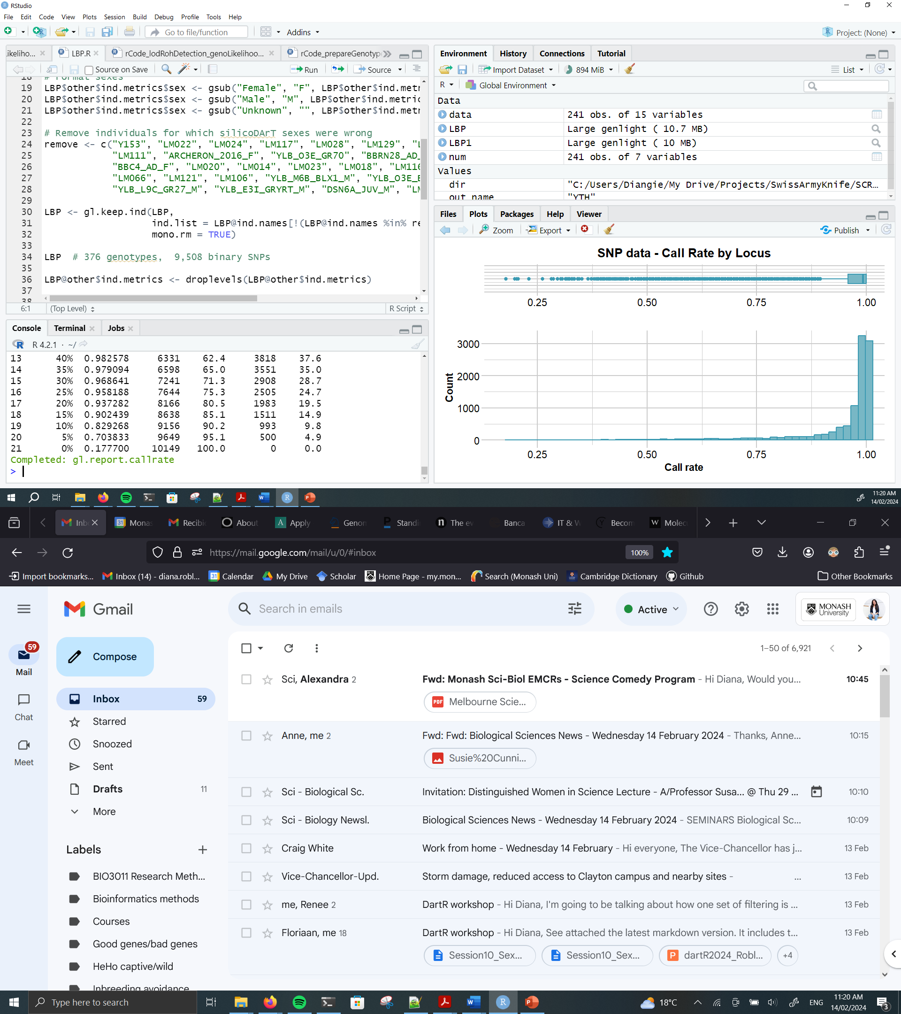
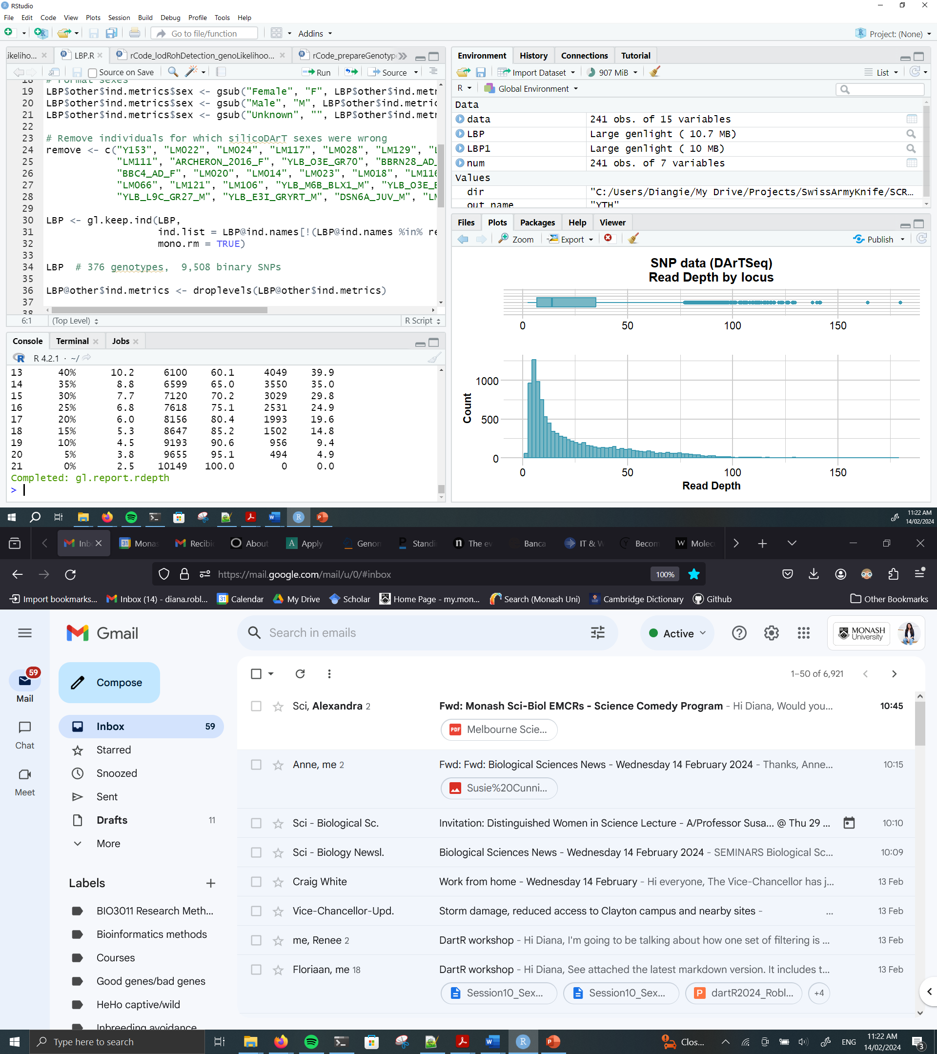
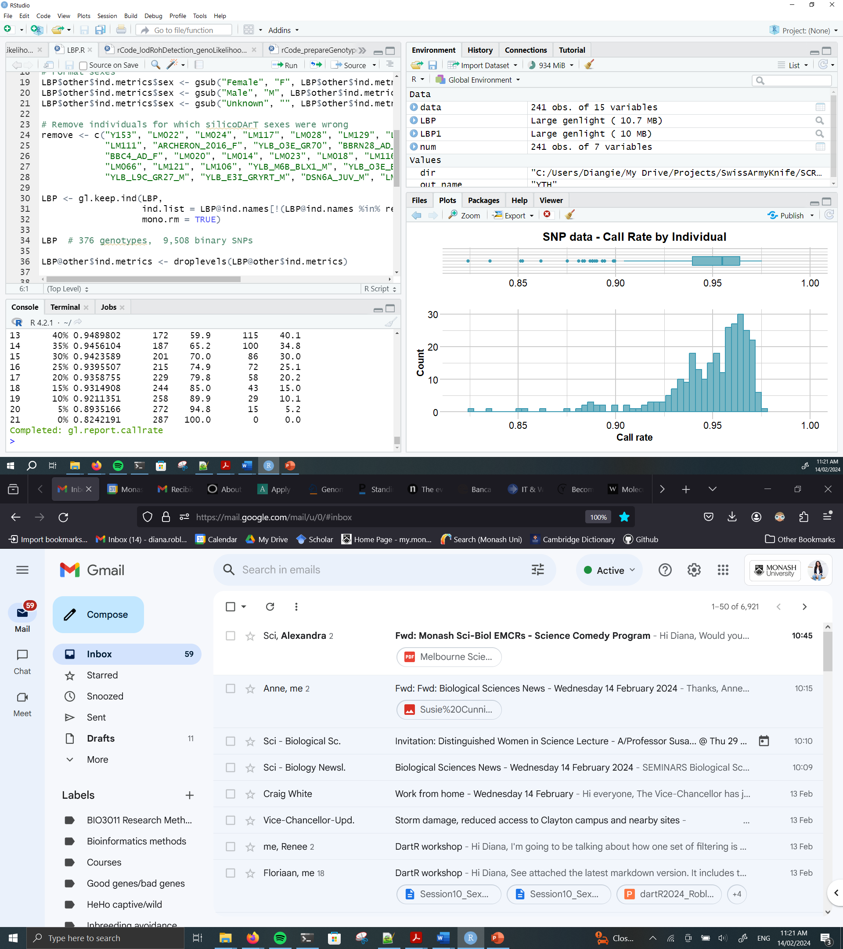
Mammal (XY)
Autosomal
Notes:
This is real SNP data for a mammal population. This is the…
Can you think why you should filter out sex-linked loci first?

Slide 103
Mammal (XY)
Y-linked
sex-linked
Males (XY)
Autosomal
Notes:
Because these loci here, are probably Y-linked loci (absent in females). These guys here are most probably males and they have more missing data because they only have 1 X chromosome.
Or these loci here, are very likely sex-linked and have less read depth.
So if you apply your standard filters here, you are not removing bad quality loci or individual, you are simply removing some sex-linked loci

Slide 104
Mammal (XY)
Y-linked
sex-linked
Males (XY)
Remove sex-linked loci first to guarantee that:
- You won’t unfairly remove inds from one sex
- Downstream filters remove bad-quality loci
Autosomal
Notes:
Therefore, by removing sex-linked loci first we guarantee that the quality filters applied downstream (1) won’t unfairly remove individuals from one sex, and (2) the filters will actually remove bad-quality loci.

Slide 105
Take home message no. 3
Remove sex-linked loci FIRST
Notes:
Best practice.

Slide 106
Applications of sex-linked loci
1. REMOVE THEM: Facilitate unbiased popgen analyses
2. USE THEM:
- Sex identification of samples
Autosomal

Slide 107
Applications of sex-linked loci
1. REMOVE THEM: Facilitate unbiased popgen analyses
2. USE THEM:
- Sex identification of samples
- Study sex-biased dispersal
Autosomal

Slide 108
Applications of sex-linked loci
1. REMOVE THEM: Facilitate unbiased popgen analyses
2. USE THEM:
- Sex identification of samples
- Study sex-biased dispersal
- Study the evolution of sex chromosomes
Autosomal

Slide 109
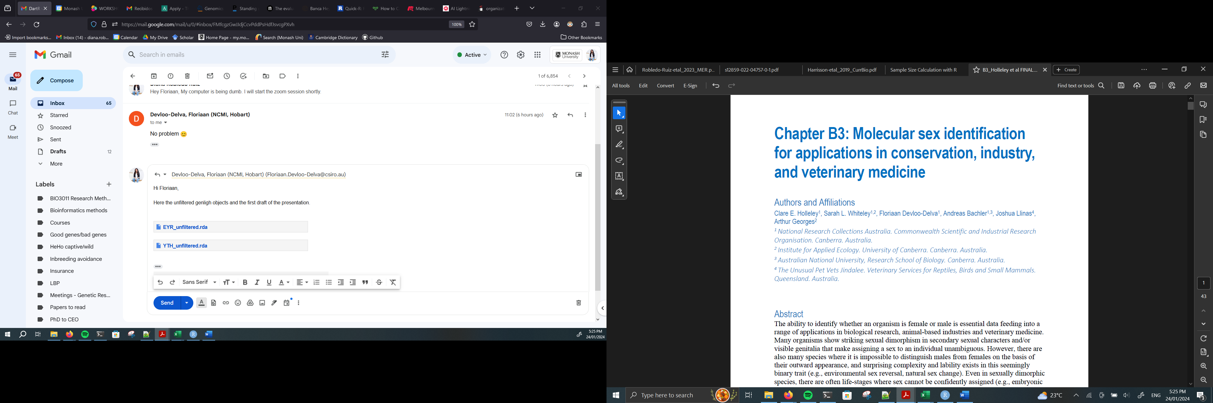
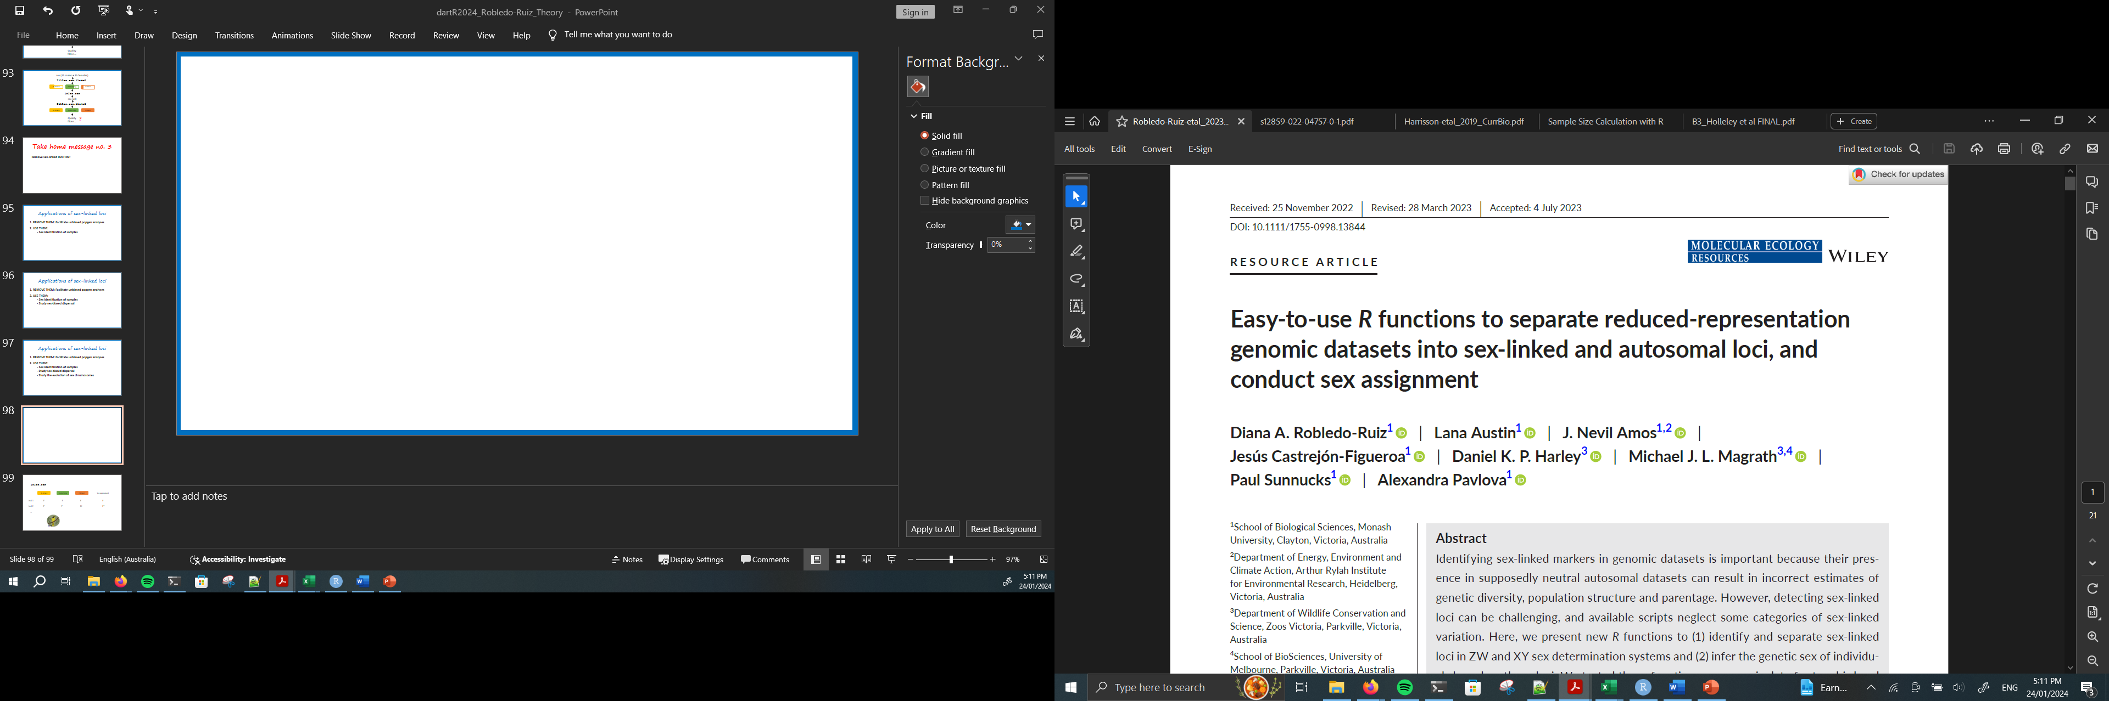
Autosomal

Slide 110
Questions?
Autosomal

